Slide 1


Chapter # 9 Ex# 9.3
Infinite Series

Slide 2


Infinite Series:
Let $\frac{1}{3},$we know that:
$\frac{1}{3}$ = 0.33333333……..

Slide 3



Slide 4
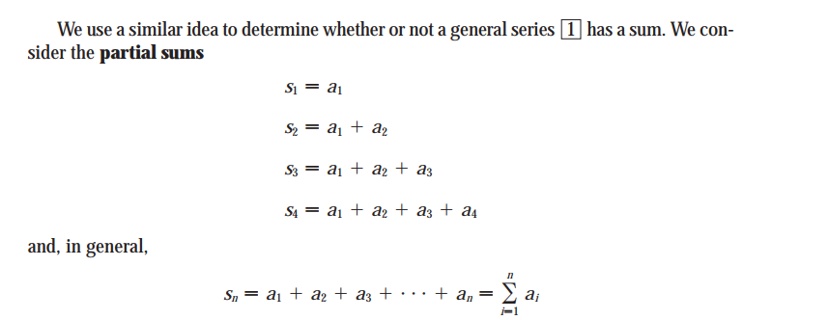

Slide 5
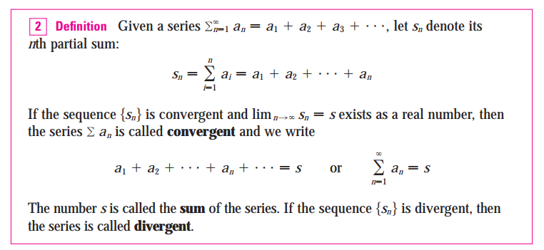

Slide 6


Slide 7


Slide 8
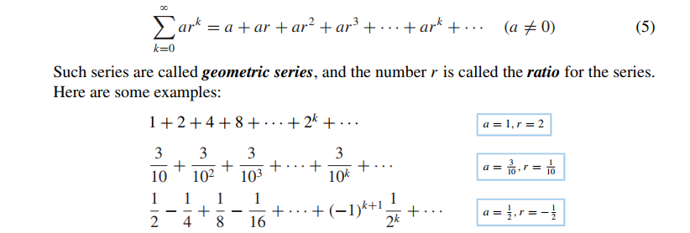
Geometric Series:

Slide 9
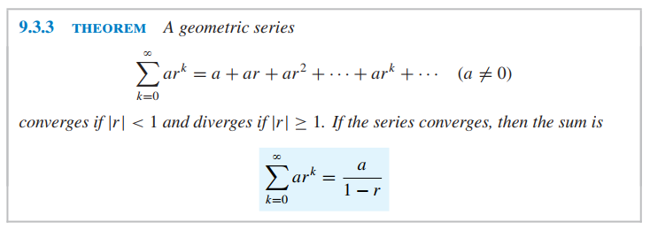

Slide 10
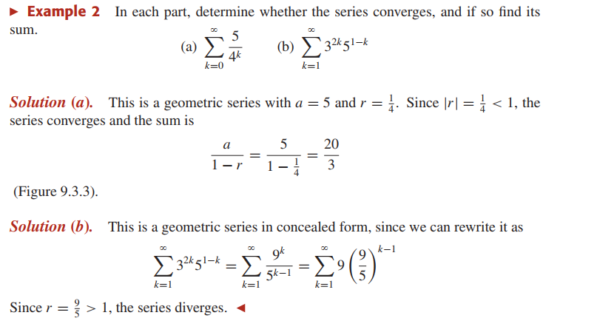

Slide 11


Slide 12




Slide 13
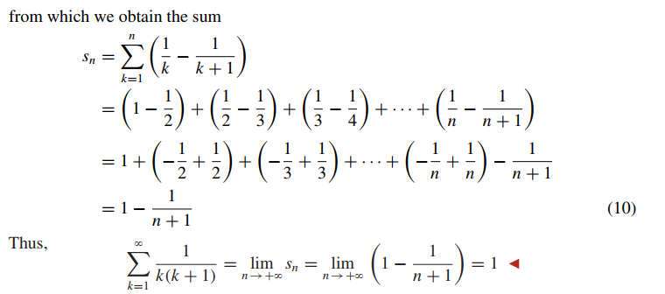


Slide 14
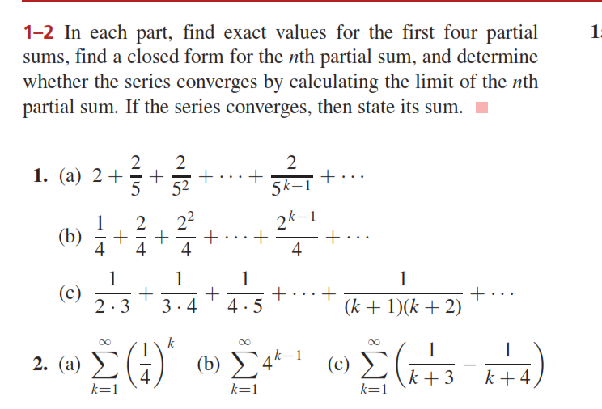

Slide 15
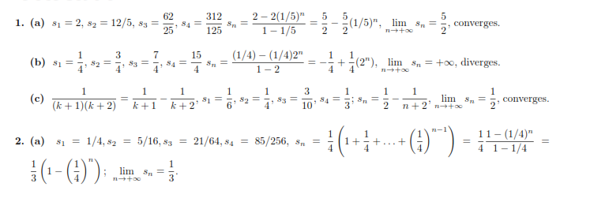

Sol:

Slide 16
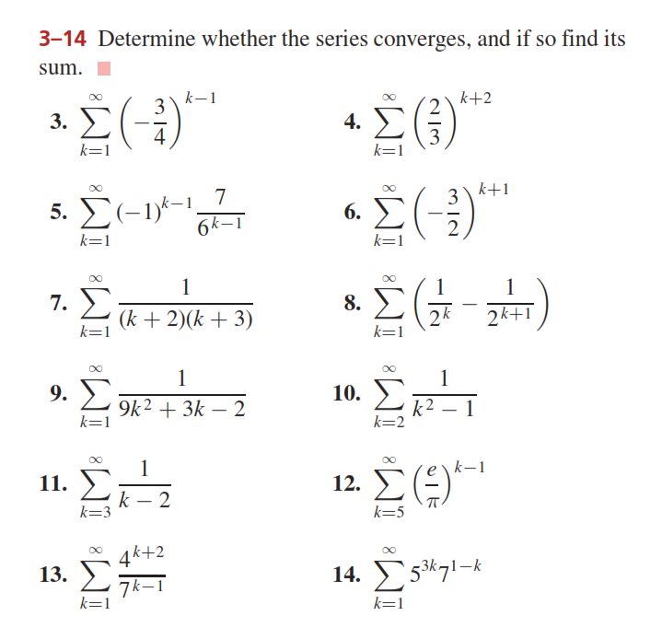

Slide 17
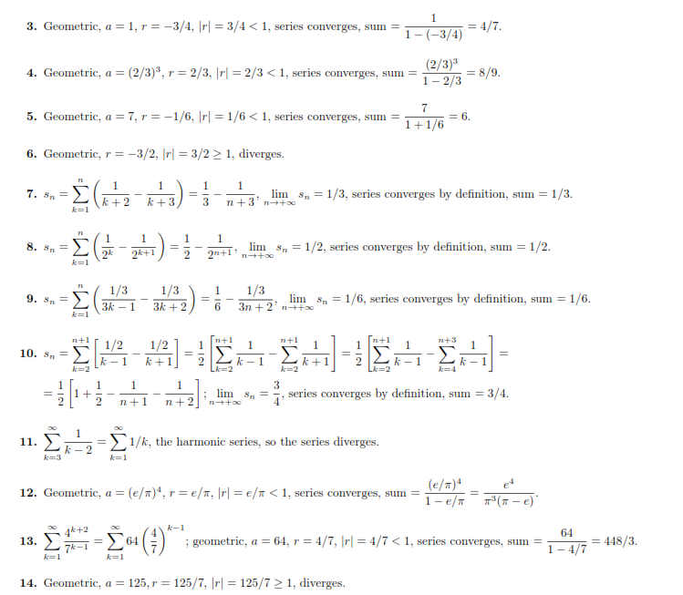
Sol:

Slide 18
Do Questions (1-14) from Ex # 9.3

